Slide 1
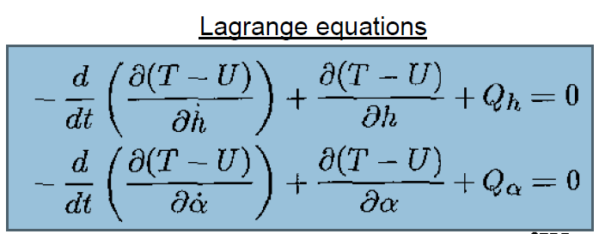
Aeroelasticity – Optional Class Project
Investigation of the Differential Equation the Lagranian
T-U for a Typical (Wing) Section
From: Raul Garcia, IAS, UPRM
Aeroelasticity class project
Phone: 787-609-4000 x4445
For Professor: Stefano Leonardi Moretti, Ph.D.
Date: 12-12-11

Slide 2
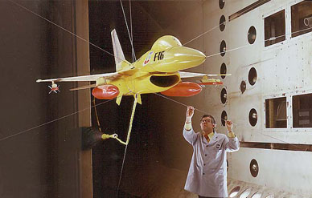

Background
Source: Aeroelasticity UPRM Grad Course, 2011
Professor: Stefano Leonardi Moretti, Ph.D.
Class #7-8, Given at Infotech Aerospace
Aeroelasticity Class 7 and 8

Slide 3
Flutter is a self-feeding and potentially destructive vibration where aerodynamic forces on an object couple with a structure's natural mode of vibration to produce rapid periodic motion. Flutter can occur in any object within a strong fluid flow, under the conditions that a positive feedback occurs between the structure's natural vibration and the aerodynamic forces. That is, the vibrational movement of the object increases an aerodynamic load, which in turn drives the object to move further. If the energy input by the aerodynamic excitation in a cycle is larger than that dissipated by the damping in the system, the amplitude of vibration will increase, resulting in self-exciting oscillation. The amplitude can thus build up and is only limited when the energy dissipated by aerodynamic and mechanical damping matches the energy input, which can result in large amplitude vibration and potentially lead to rapid failure.
Because of this, structures exposed to aerodynamic forces — including wings and aerofoils, but also chimneys and bridges — are designed carefully within known parameters to avoid flutter.
In complex structures where both the aerodynamics and the mechanical properties of the structure are not fully understood, flutter can only be discounted through detailed testing. Even changing the mass distribution of an aircraft or the stiffness of one component can induce flutter in an apparently unrelated aerodynamic component.
At its mildest this can appear as a "buzz" in the aircraft structure, but at its most violent it can develop uncontrollably with great speed and cause serious damage to or lead to the destruction of the aircraft as in Braniff Flight 542.
Source:
http://en.wikipedia.org/wiki/Aeroelastic_flutter#Flutter

Slide 4
Flutter
DYNAMIC AEROELASTICITY
The principal phenomena of interest are 'flutter' or dynamic instability and response to various dynamic loadings as modified by aeroelastic effects.
…
We now turn to a discussion of energy and work methods which proven very useful for the development of structural equations of motion. In principle, one may use Newton's Second Law to obtain the Equations of motion for any elastic body. However, an alternative procedure based on Hamilton's Principle or Lagrange Equations is used. For systems with many degrees of freedom, the latter axe more economical and systematic.
Source: Aeroelasticity UPRM Course, 2011
Professor: Stefano Leonardi Moretti, Ph.D.
Class #7, Given at Infotech Aerospace

Slide 5
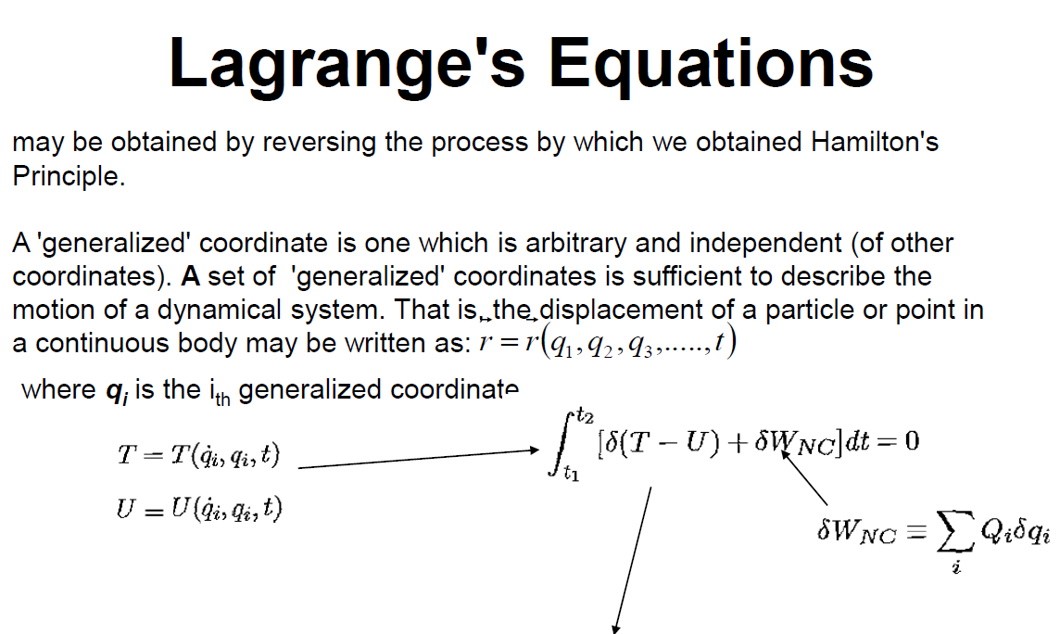

Source: Aeroelasticity UPRM Course, 2011
Professor: Stefano Leonardi Moretti, Ph.D.
Class #8, Given at Infotech Aerospace

Slide 6
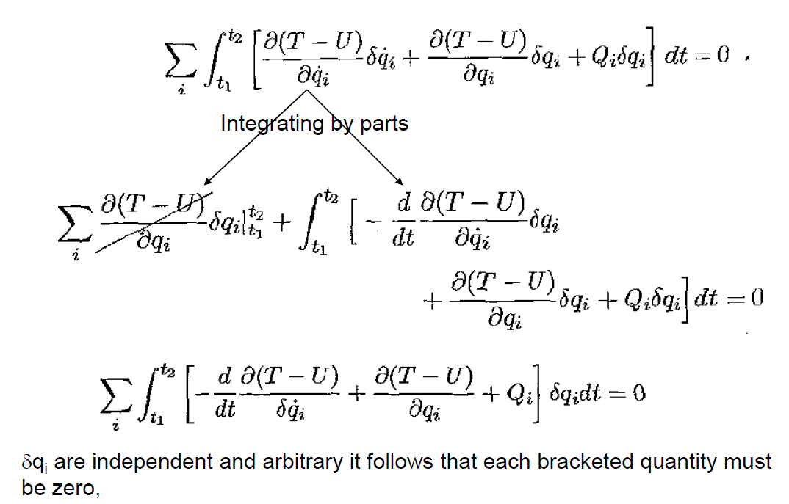
Source: Aeroelasticity UPRM Course, 2011
Professor: Stefano Leonardi Moretti, Ph.D.
Class #8, Given at Infotech Aerospace

Slide 7

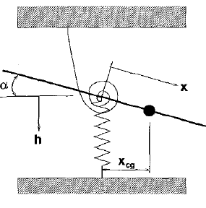
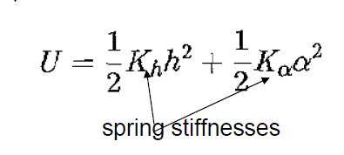
Source: Aeroelasticity UPRM Course, 2011
Professor: Stefano Leonardi Moretti, Ph.D.
Class #8, Given at Infotech Aerospace

Slide 8
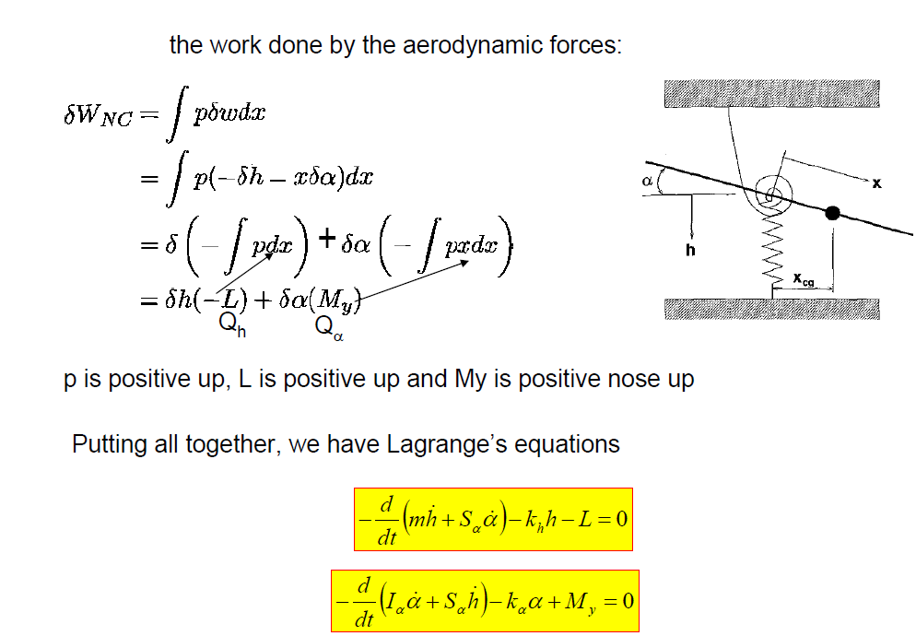
Source: Aeroelasticity UPRM Course, 2011
Professor: Stefano Leonardi Moretti, Ph.D.
Class #8, Given at Infotech Aerospace

Slide 9
Proposed Research

Slide 10
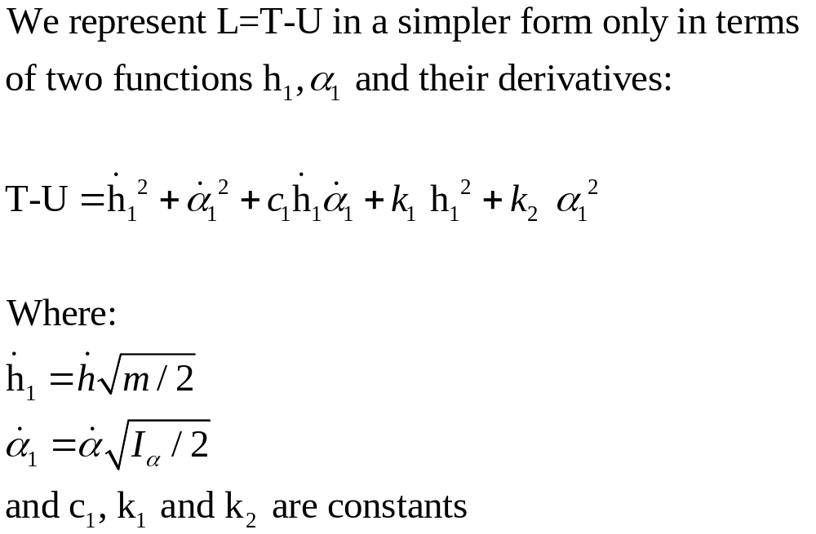
Research Summary
By using the linearity of the derivative

Slide 11

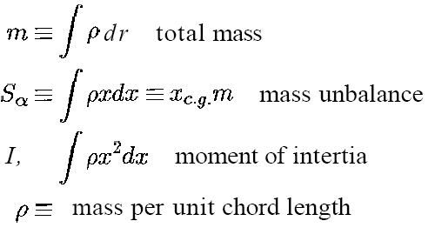
Based on derivations on the Class lecture #7-8:
Typical section equations of motion

Slide 12
Based on derivations on the Class lecture #7-8:
Typical section equations of motion
Source: Aeroelasticity UPRM Course, 2011
Professor: Stefano Leonardi Moretti, Ph.D.
Class #8, Given at Infotech Aerospace

Slide 13
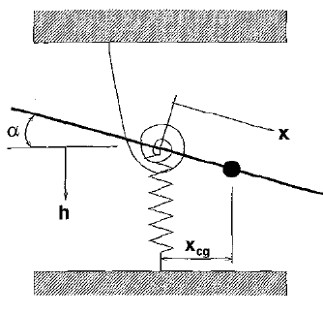
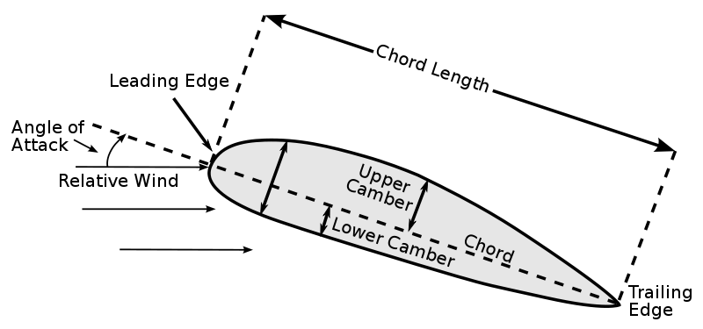
Source: Aeroelasticity UPRM Course, 2011
Professor: Stefano Leonardi Moretti, Ph.D.
Class #8, Given at Infotech Aerospace

Slide 14
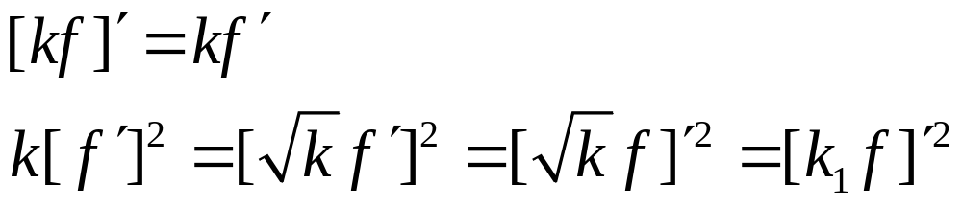
Method Summary
We find a way to express the Lagranian for a typical section that is based on two functions and their derivatives
We ‘rollup’ many needed constants (or negative signs) into single values to extract the essence of the non-linear differential eq’n L=T-U
Note the forms below are both based on the form ‘kf’
This is founded on the simple fact below when k is a constant (thus the square root of k too, k>0):

Slide 15
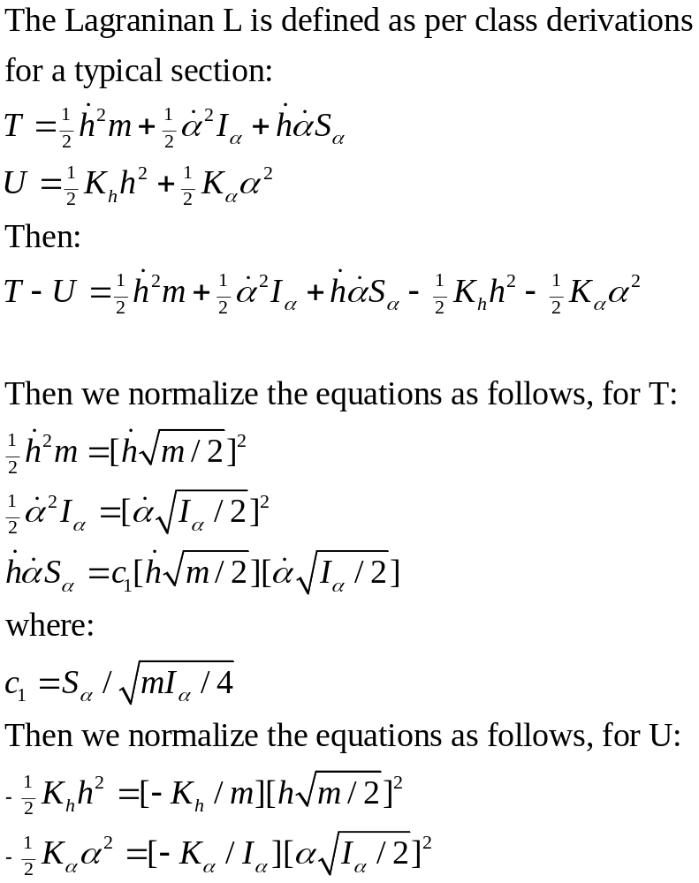

Slide 16
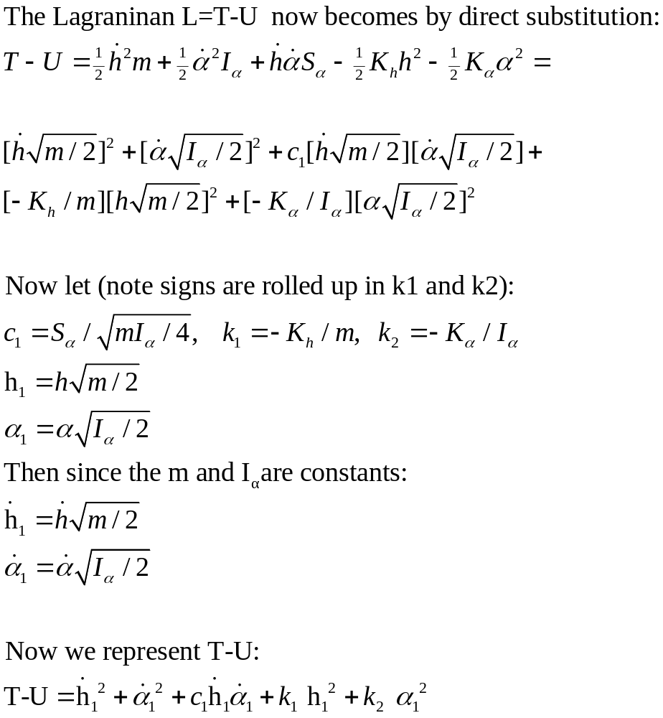

Slide 17
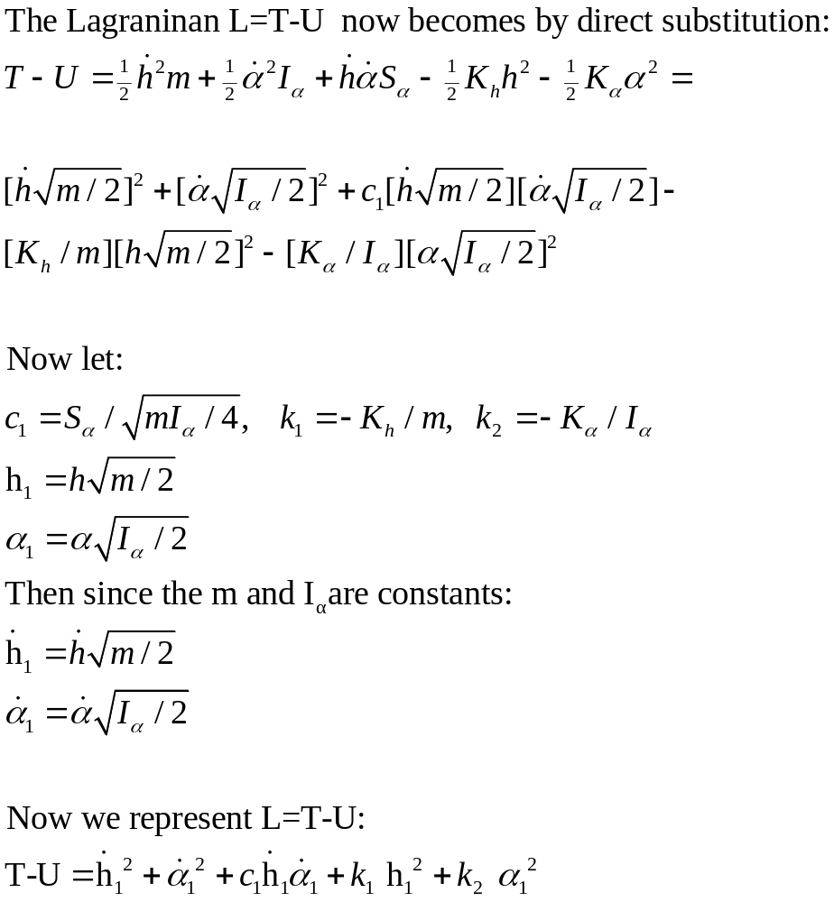

Slide 18
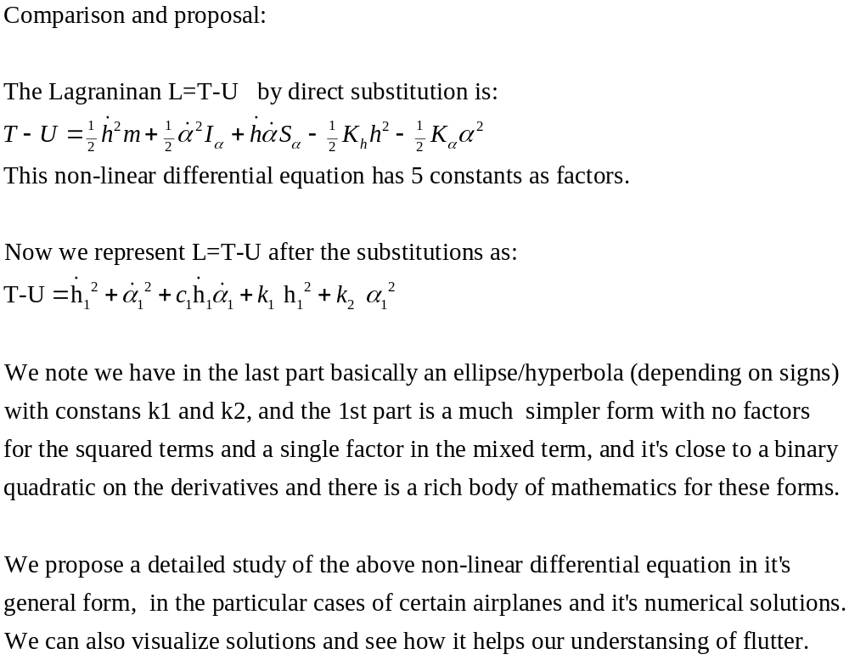

Slide 19
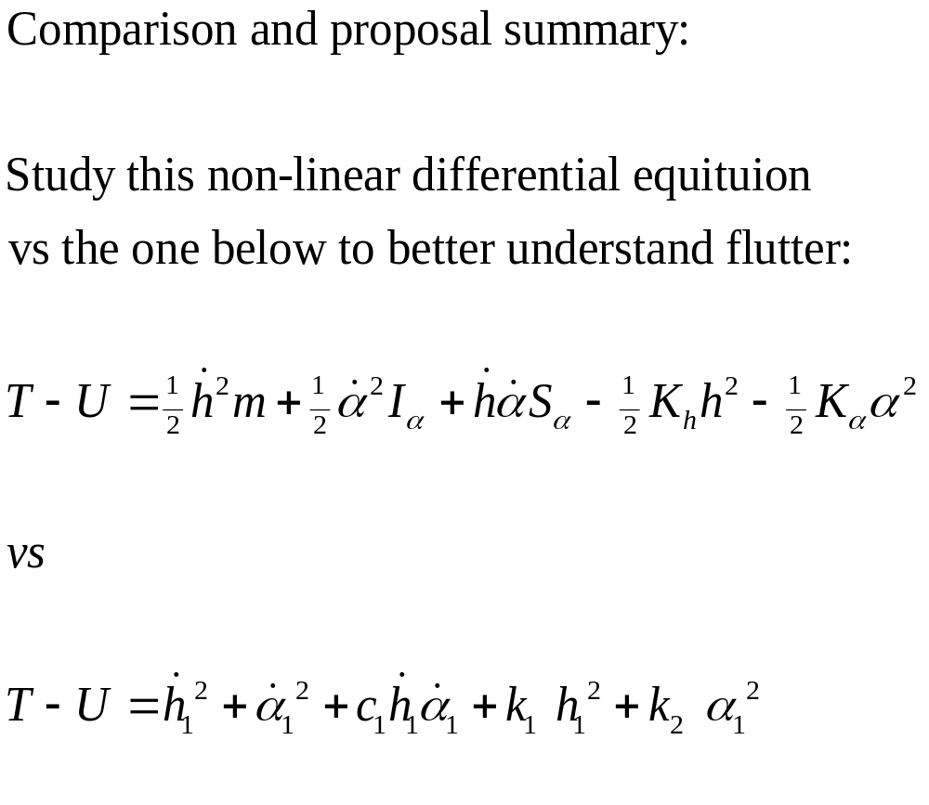

Slide 20
Now that we have a simpler form of the L=T-U for a typical section we now have some attempts to graph the solution of this complex non-linear differential equation
Note:
It’s non-linear due to squared terms, we vary h and alpha using the meshgrid command and see the behaviour of the equation for any such pair of points. Since alpha is an angle of attack we use radians for it.
The first plot has k1 and k2 set to 1 for simplicity,
Later we explore using the Aluminum values, were k1 is of the order of 10^6 and k2 has a max order of 10^2

Slide 21
% t-u in sys eqs
% HERE X1 AND X2 ARE THE SAME
NX=20;
L1=1
H=0:L1/NX:L1;
L2=2*pi;
A=0:L2/NX:L2
%% VARY ALL POSSIBLE DIST H
%% AND ANGLES A into mesh [h,a]
[h,a]=meshgrid(H,A);
% store dim in N
[M,N]=size(H)
x=1;
%% typical airfoil section
C=1;
K1=-1;
K2=-1;
figure
step=0
% only x remains to vary
S=H % same as H from 0 to 1
Matlab code for k1 and k2 = -1
for x=0:1:10;
step=step+1
if (N-step > 1)
%% typical airfoil section - now take the values of x per plot
F=x.*[cos(a)-1];
G=-h-x.*sin(a);
% 1ST PART DERIVATIVES ON t
FD1=diff(F);
GD1=diff(G);
% REDUCE 1 COL SINCE DIFF REDUCES DATA BY 1 COL
F2=F(1:N-step,:)
G2=G(1:N-step,:)
TU=FD1.^2 + GD1.^2 + 2*F2.*G2 + K1.*F2.^2 + K2.*G2.^2
h=h(1:N-step,:)
a=a(1:N-step,:)
%axis([0 1 0 6 0 500])
subplot(5,2,step); surf(h,a,TU)
xlabel 'Variation in height h'
ylabel 'Variation in angle alpha'
zlabel 'Lagrange T-U'
end
end

Slide 22
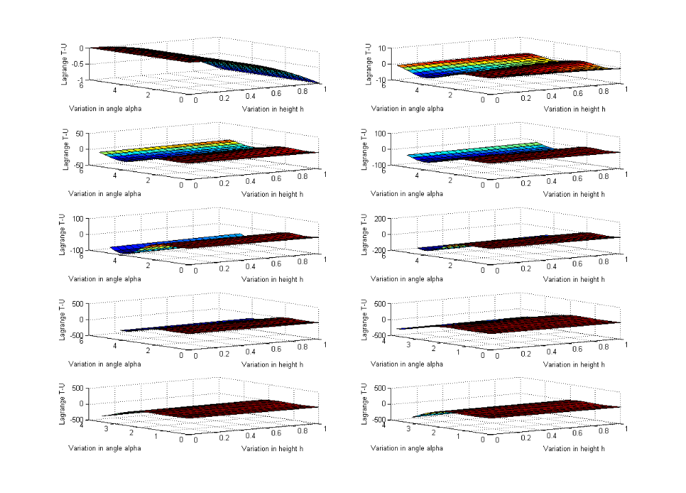
K1= -1 and K2= -1, we vary x from 1 to 10 steps of 1, typical section

Slide 23
% t-u in sys eqs
% HERE X1 AND X2 ARE THE SAME
NX=20;
L1=1
H=0:L1/NX:L1;
% L2=2*pi;
L2=pi/10 % up to 180/10 or 18 degrees
A=0:L2/NX:L2
%% VARY ALL POSSIBLE DIST H AND ANGLES A into mesh [h,a]
[h,a]=meshgrid(H,A);
% store dim in N
[M,N]=size(H)
x=1;
%% typical airfoil section
C=1;
%http://www.engineeringtoolbox.com/aluminum-i-beams-d_1326.html
% aluminum -
K1=6.2*10^10;
K2=300; % MAX VALUE FOR ALUM BEAM
figure
step=0
% only x remains to vary
S=H % same as H from 0 to 1
for x=0:.5:10;
step=step+1
if (N-step > 1)
%% typical airfoil section - now take the values of x per plot
F=x.*[cos(a)-1];
G=-h-x.*sin(a);
% 1ST PART DERIVATIVES ON t
FD1=diff(F);
GD1=diff(G);
% REDUCE 1 COL SINCE DIFF REDUCES DATA BY 1 COL
F2=F(1:N-step,:)
G2=G(1:N-step,:)
TU=FD1.^2 + GD1.^2 + 2*F2.*G2 - K1.*F2.^2 - K2.*G2.^2
h=h(1:N-step,:)
a=a(1:N-step,:)
surf(h,a,TU)
xlabel 'h - Height variable'
ylabel 'a - Angle of Attack Radians'
hold on
%pause
end
end
title 'For Aluminun Wing with k1=6.2*10^10 and k2=300 (beam max value)'

Slide 24
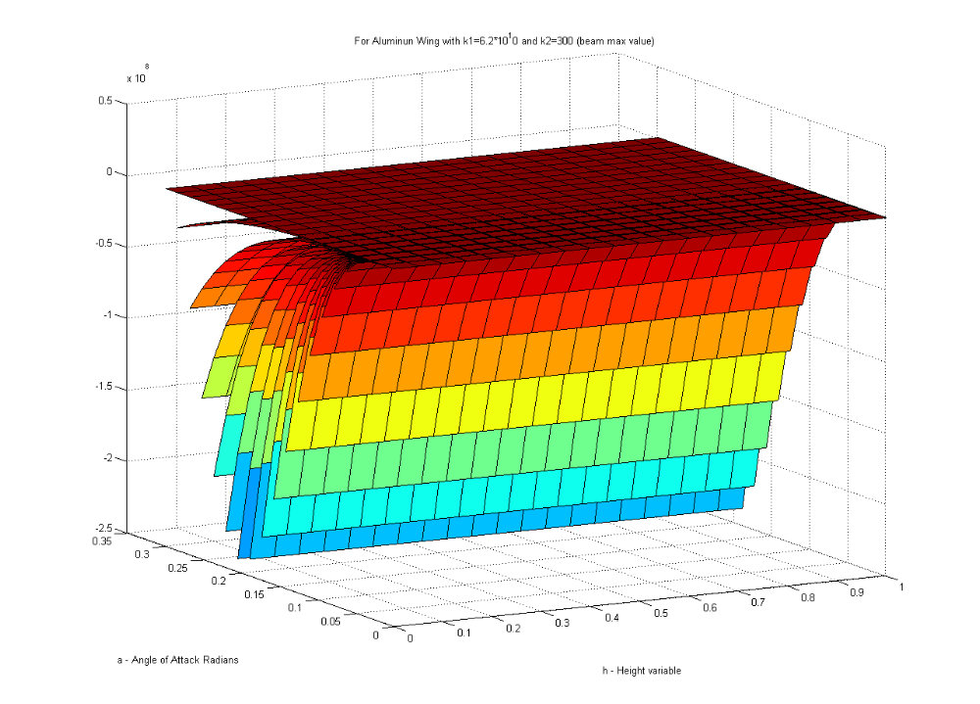

Slide 25
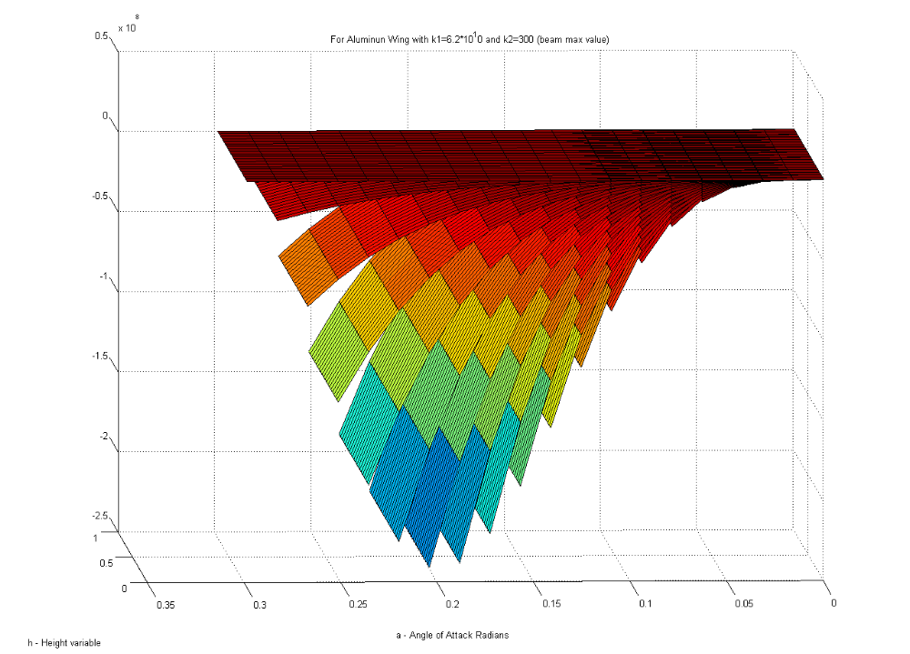

Slide 26
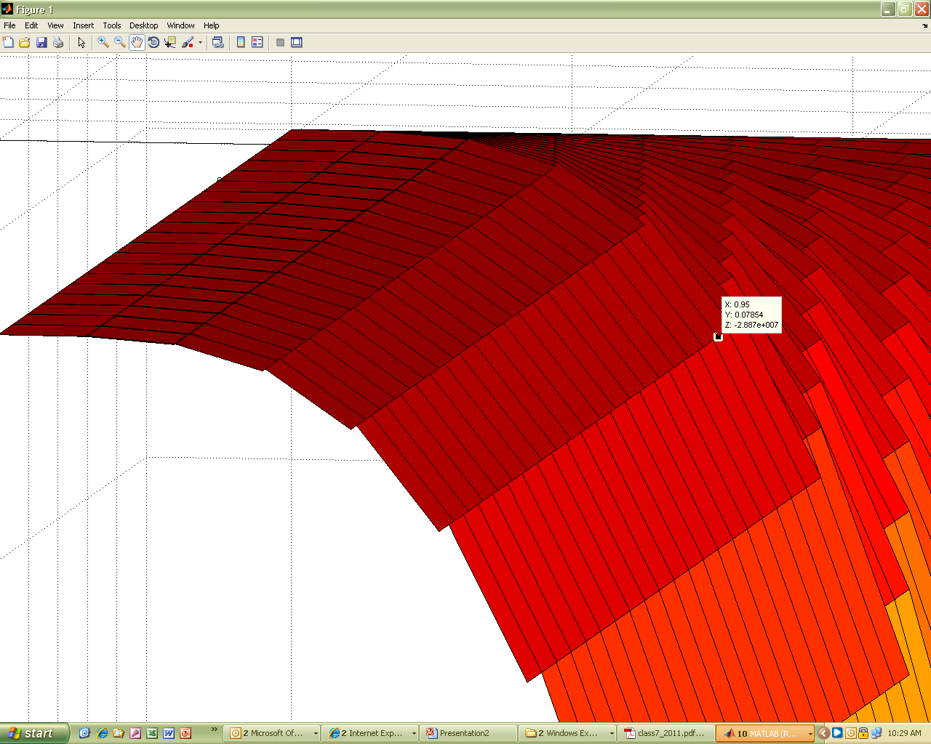

Slide 27
References
The Long History of Flutter
Flutter has destroyed countless airplanes since the early days of flying. Before 1930s, little was understood of flutter. The spirit of adventure prevailing in those "barn-storming" days of aviation encouraged the aviators to take great risks with the new sport. Many "cowboy" types even routinely sawed-off portions from the airplane wing-tips in order to get a better aerobatic performance out of their low-powered and flimsy machines. One will never know how many of these intrepid souls succumbed to flutter. In the 1930s, with the availability of better engines and in attempts to set new flying speed records, flutter began to be recognized as the death-trap it was. Consequently, serious engineering effort in analysing and preventing flutter began in earnest, especially in the design of the faster fighter aircrafts of the 1930s and '40s. One obvious solution was to dramatically increase the structural stiffness, but this was not always possible due to weight considerations.
When experiments and analytical models revealed that the flight velocity at which flutter occurs and its characteristic frequency are as much affected by the mass distribution of the structure as its stiffness, mass balancing of the wings, tails and control-surfaces began to be an integral part of aircraft construction. With the passage of time, as the maximum flight velocities of aircrafts increased beyond the speed of sound, it was noticed that flutter was most likely at the transonic speed (close to the speed of sound) due to the unsteady motion of a shock wave on top of the wing.
Therefore, a better modelling of the unsteady aerodynamic loads in the transonic regime was required, which resulted in computer codes that had run-time of weeks on the Cray supercomputers. Consequently, the world's largest supercomputer, namely the National Transonic Facility (NTF) of U.S.A., was dedicated to address the unsteady transonic aerodynamic problem. At the same time, experimental facilities at organisations such as NASA-Langley Research Centre were upgraded to study transonic flutter. The valuable data resulting from these studies were applied to most of the airplanes we see flying today, such as Boeing 747-400 and Airbus A-340, which routinely cruise at transonic speeds.
http://www.iitk.ac.in/infocell/Archive/dirjan1/flutter.html

Slide 28
References
Boeing 787 Completes Critical Flutter Testing
inShareBy Jason Paur Email Author March 19, 2010 | 8:05 pm
Boeing passed a major milestone today in the 787 Dreamliner program. Today’s flight test of airframe ZA001, the first 787 to fly back in December, marks the end of flutter testing for the airplane. Wired.com was in Boeing’s telemetry room today in Seattle and will have a full report of flight testing from the engineers perspective on Monday.
Flight test engineers and test pilots at Boeing have been performing flutter tests for the past several weeks concluding with a 3 hour 48 minute flight today (photo is ZA001 departing Boeing Field this morning). Flutter testing is a critical part of the envelope expansion for any new airplane. Until the testing is complete, flight test aircraft may be limited to certain speeds, altitudes and weights during various maneuvers.
During the flutter testing flights, pilots introduce a range of vibration frequencies to the flight surfaces and flight control surfaces to ensure the design of the aircraft dampens out the oscillations without further input from the pilots. These oscillations are introduced by hand as well as via computer.
With the successful conclusion today, the four 787 flight test aircraft currently flying can now fly throughout the complete speed range of the aircraft. During flutter testing, speeds as high as Mach 0.97 were flown and altitudes up to 43,000 feet.
http://www.google.com/imgres?imgurl=http://www.wired.com/images_blogs/autopia/2010/03/img_8358-660x439.jpg&imgrefurl=http://www.wired.com/autopia/2010/03/boeing-787-completes-critical-flutter-testing/&usg=__MEs4Znve4igDRZwbWt3mYA6-9zM=&h=439&w=660&sz=26&hl

